Slide 1
Specialization and Trade
Rajiv Sethi and the CORE Team
September 15, 2021

Slide 2
Overview
Capitalism as a Mode of Production
What caused the hockey stick?
Absolute and Comparative Advantage
Specialization and the Gains from Trade
Reading: The Economy Units 1.6 to 1.8

Slide 3
Economic Systems

Slide 4
Economic Systems
What do we mean by an economic system?
Set of laws and customs that organize production and distribution
Examples: slavery, feudalism, capitalism
No system is pure; most involve mix of features
Key features of capitalism: private property, markets, and firms

Slide 5
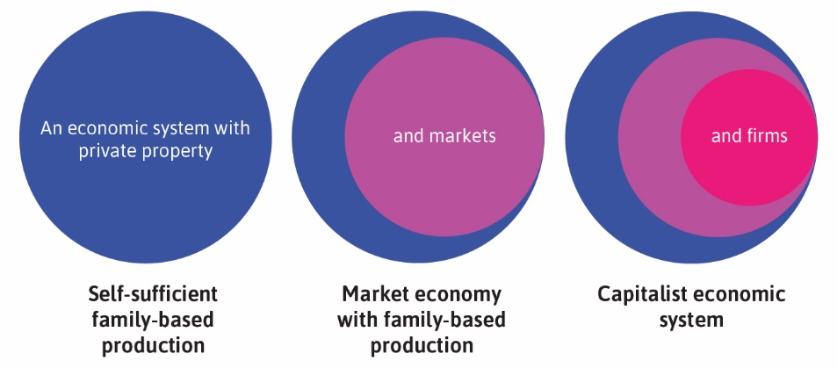

Slide 6
Firms and Markets
Firms are legal entities, themselves owned by people
They include sole proprietorships, partnerships, and corporations
Example: law firms are typically partnerships
Large firms (Apple, Netflix, Boeing, WalMart) are typically corporations
Corporations can have millions of owners (shareholders)
Firms use inputs to produce and sell outputs in markets for profit
Inputs are tangible (labor, equipment) or intangible (patent, copyright)
Markets are sites (physical/virtual) where voluntary transactions occur

Slide 7
Capitalism and Growth
Capitalism emerged around the same time as kinks in hockey stick
But was capitalism the cause of growth acceleration?
Competition among firms creates incentive for innovation
Market expansion allows for greater specialization in production
But causation is much harder to establish than correlation
Other factors: institutionalization of scientific method
Colonial expansion expanded access to resources and markets
Growth also depends on political systems

Slide 8
Political Systems
What do we mean by a political system?
Set of laws/customs that determine how governments are selected
And how they make decisions
Examples: monarchy, dictatorship, democracy
Again, no system is pure; most involve mix of features
Capitalism can coexist with democratic and non-democratic systems
Governments also provide goods/services in capitalist economies
Examples: infrastructure, scientific research, education
Size and role of government varies a lot across capitalist economies

Slide 9
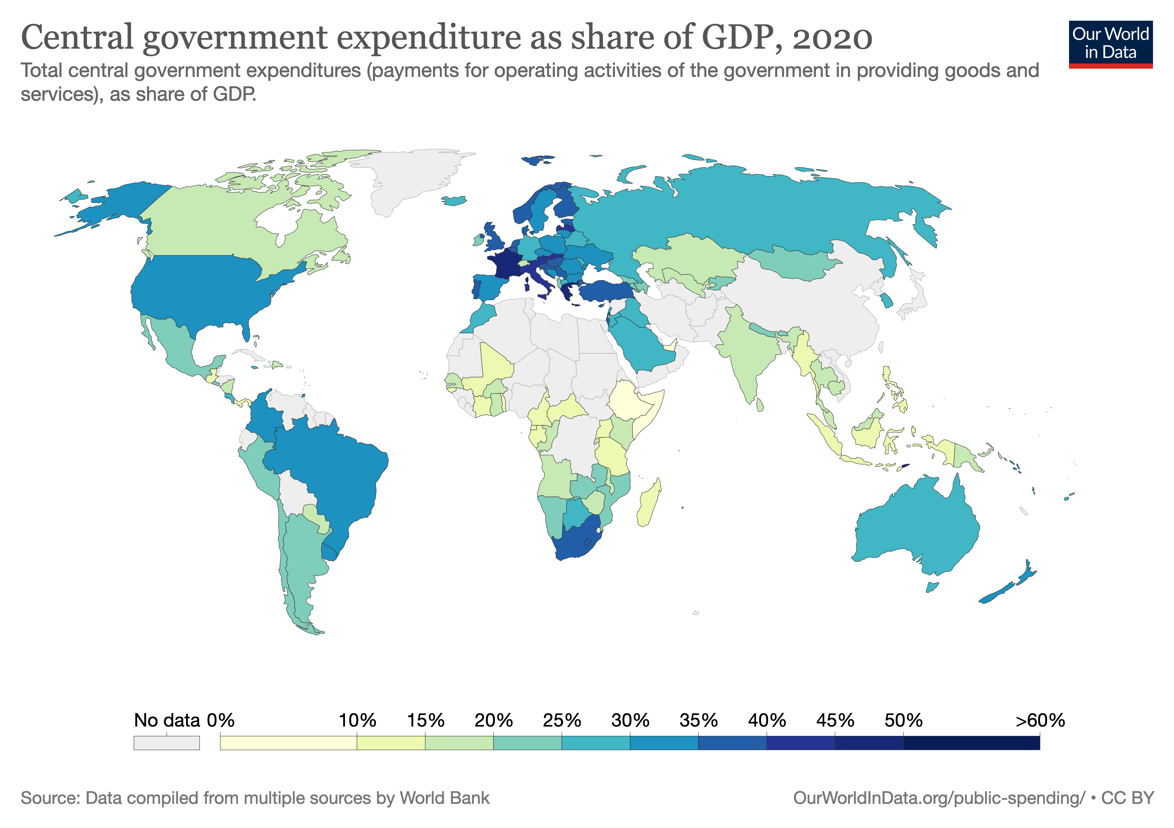
View Latest Data

Slide 10
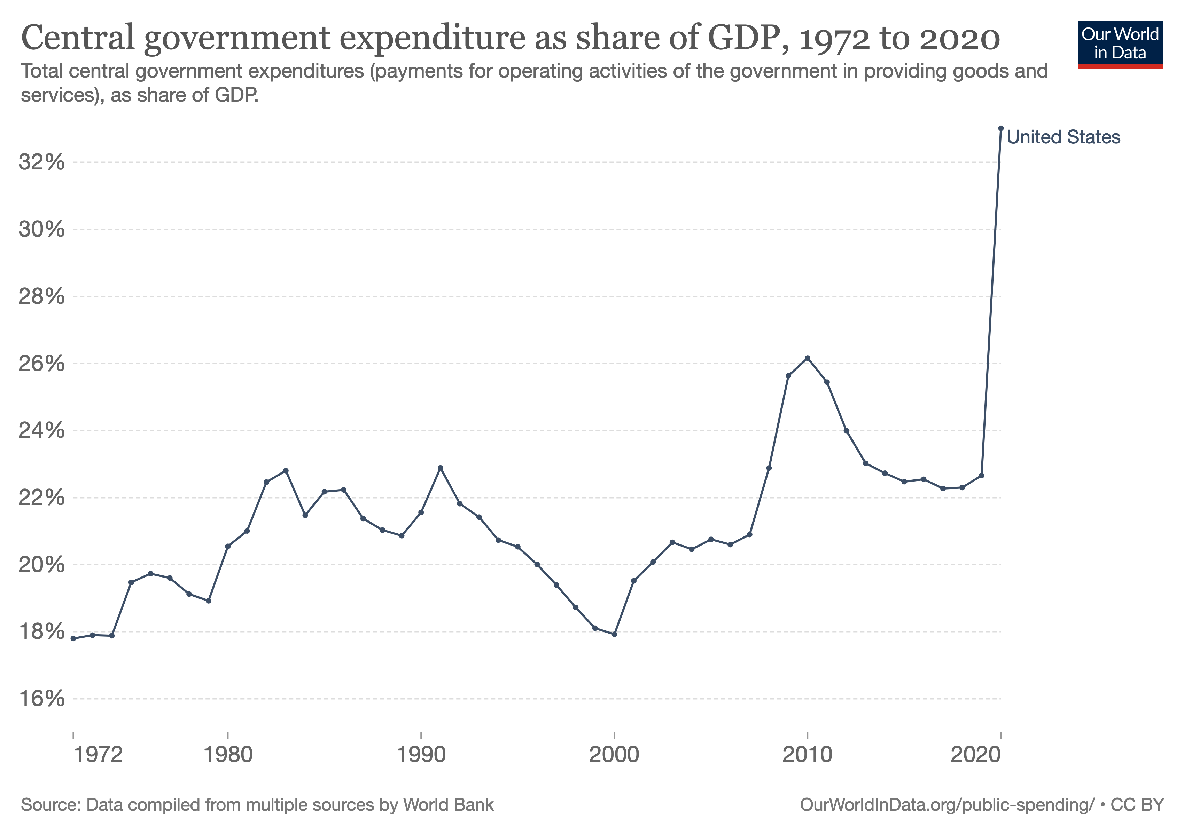
View Latest Data

Slide 11
Specialization and Trade

Slide 12
Specialization
Much of what we consume is produced in bits and pieces
Different components made in different parts of the world
Designed, manufactured, and assembled by different teams
Each team is specialized in a particular operation
All part of what are called global supply chains
Allowing for production on a massive scale
Adam Smith (1776) observed early emergence of this process

Slide 13
One man draws out the wire, another straights it, a third cuts it, a fourth points it, a fifth grinds it at the top for receiving, the head; to make the head requires two or three distinct operations; to put it on is a peculiar business, to whiten the pins is another; it is even a trade by itself to put them into the paper; and the important business of making a pin is, in this manner, divided into about eighteen distinct operations… I have seen a small manufactory of this kind where ten men only were employed… Those ten persons… could make among them upwards of forty-eight thousand pins in a day. Each person, therefore, making a tenth part of forty-eight thousand pins, might be considered as making four thousand eight hundred pins in a day. But if they had all wrought separately and independently… they certainly could not each of them have made twenty, perhaps not one pin in a day
Adam Smith (1776)

Slide 14
Comparative Advantage
 | Production if 100% of time is spent on one good
Greta | 1250 apples or 50 pounds of wheat
Carlos | 1000 apples or 20 pounds of wheat
Greta has an absolute advantage in producing both goods
But Carlos has a comparative advantage in producing apples
He can produce more apples for each pound of wheat given up
And Greta has has a comparative advantage in producing wheat

Slide 15
Self-Sufficiency
Suppose Greta and Carlos are each self-sufficient
Greta spends 40% of her time on apples, 60% on wheat
Carlos spends 25% of his time on apples, 75% on wheat
How much of each good does each person produce?
How much of each good is produced in the economy?

Slide 16
 | Greta |  |  |  | Carlos |  |  |  | Total
 | Apples |  | Wheat |  | Apples |  | Wheat |  | Apples | Wheat
 | Share | Output | Share | Output | Share | Output | Share | Output | Output | Output
Only Apples | 100% | 1,250 | 0% | 0 | 100% | 1,000 | 0% | 0 | 2,250 | 0
Only Wheat | 0% | 0 | 100% | 50 | 0% | 0 | 100% | 20 | 0 | 70
Mixture | 40% | 500 | 60% | 30 | 25% | 250 | 75% | 15 | 750 | 45

Slide 17
Gains from Specialization
Suppose each produces according to comparative advantage
How much of each good is produced in the economy?
If total output is greater for both goods under specialization
There must be a price at which they could profitably trade
Example: 34 apples per unit of wheat, 18 units of wheat traded
At different prices, distribution of gains from trade vary
What is lowest price (apples per wheat unit) at which trade can occur?
What is highest price (apples per wheat unit) at which trade can occur?
Who gains the most in each case?

Slide 18
 | Greta |  |  |  | Carlos |  |  |  | Total |  | Price | Trade
 | Apples |  | Wheat |  | Apples |  | Wheat |  | Apples | Wheat
 | Share | Output | Share | Output | Share | Output | Share | Output | Output | Output
Only Apples | 100% | 1,250 | 0% | 0 | 100% | 1,000 | 0% | 0 | 2,250 | 0
Only Wheat | 0% | 0 | 100% | 50 | 0% | 0 | 100% | 20 | 0 | 70
Mixture | 40% | 500 | 60% | 30 | 25% | 250 | 75% | 15 | 750 | 45
Specialization | 0% | 0 | 100% | 50 | 100% | 1,000 | 0% | 0 | 1,000 | 50
Trade |  | 630 |  | 32 |  | 370 |  | 18 | 1,000 | 50 | 35 | 18
See spreadsheets (incomplete and complete) for details

Slide 19
Specialization and Trade
Specialization can leave both parties better off
Even if one of them is more productive at all tasks
But the benefits of specialization require trade
Usually accomplished through markets
Specialization also raises productivity through learning by doing
And better matching of talents to tasks

Slide 20
Incomplete Specialization
The Greta-Carlos example involves complete specialization
But what if complete specialization results in lower output of one good?
Suppose Greta spends 60% of her time on apples, 40% on wheat
And Carlos spends 50% of his time on apples, 50% on wheat
Under self-sufficiency how many apples are produced?
How many are produced under complete specialization?
Can we improve on self-sufficiency with incomplete specialization?
At what prices and quantities can trade occur?

